Slide 1
Near-Eye Heads Up Display for Skydiving and Wingsuiting
By: Jeremy Baechler, Isai Garcia Zamora and Teague McPhearson

Slide 2
Problem Statement
Improve awareness of important performance metrics in real time.
Provide an avenue for improved altitude awareness.
Collect gps and altimeter data which can be reviewed for even more information on flight efficiency and performance.
Push new ideas and implementations into the action sports arena, skydiving has been slow to adapt new technologies that put users at the controls.

Slide 3
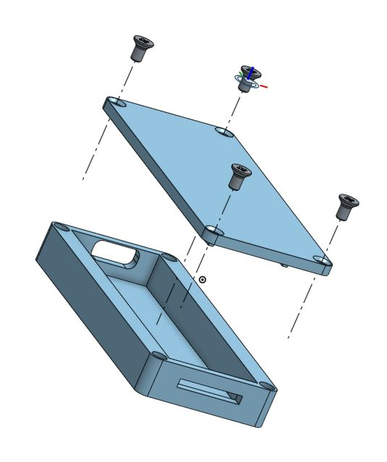
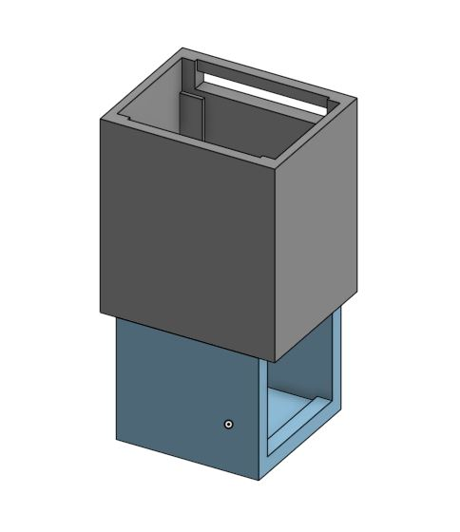
Mechanical Hardware Design
Physical Hardware
MicroDisplay
Optical Lens
Beam Splitter
Mechanical Housing for Optical and Driver Assemblies

Slide 4
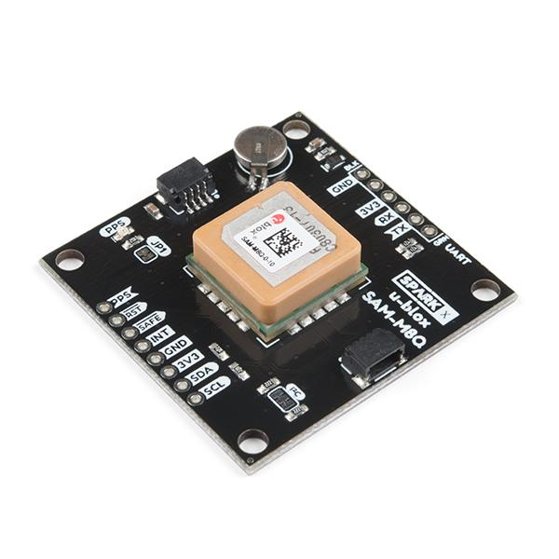
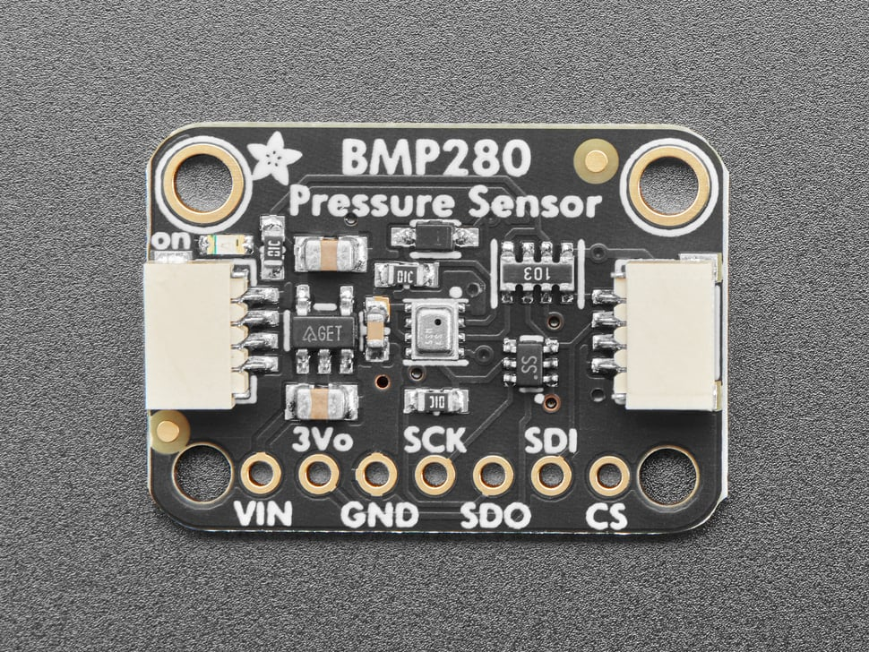
Electronics Hardware Design
Computer Hardware
Raspberry Pi 4B
BMP280 Pressure Sensor
U-blox SAM-M8Q
HDMI to USB-C Display Adapter
Printed Circuit Board Design

Slide 5
Software Design
Cross Compilation for RPi
UI Implementation
Custom Hardware Drivers
Timing Requirements

Slide 6
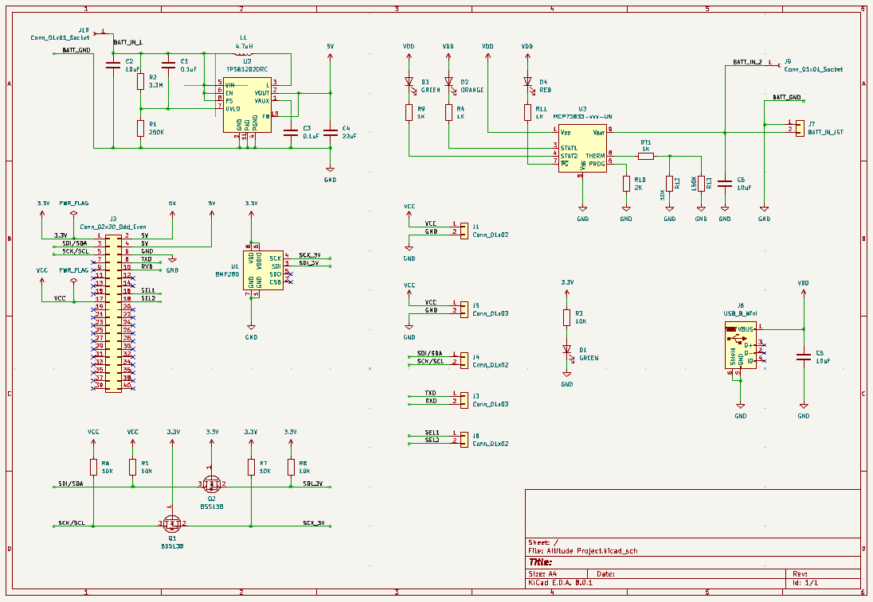
Custom PCB Design (Initial Approach)
Integrated Components
BMP280 Altimeter
TPS6120x Voltage Converter
MCP73833 Lithium Ion Battery Charger
JST Breakouts
2x20 Pin Connector
PCB schematic implementation combining altimeter, voltage converter, battery charger, and JST breakouts.

Slide 7
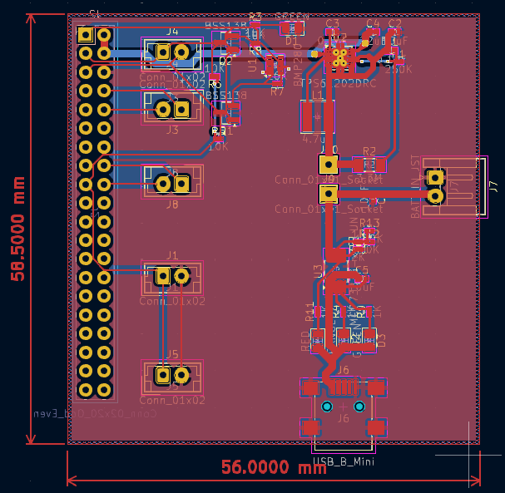
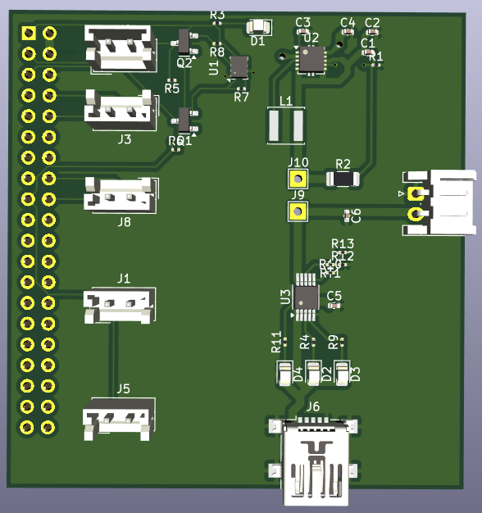
Custom PCB Design (Initial Approach)
Integrated Components
BMP280 Altimeter
TPS6120x Voltage Converter
MCP73833 Lithium Ion Battery Charger
JST Breakouts
2x20 Pin Connector
PCB layout implementation (left) and 3D view (right) combining altimeter, voltage converter, battery charger, and JST breakouts.

Slide 8
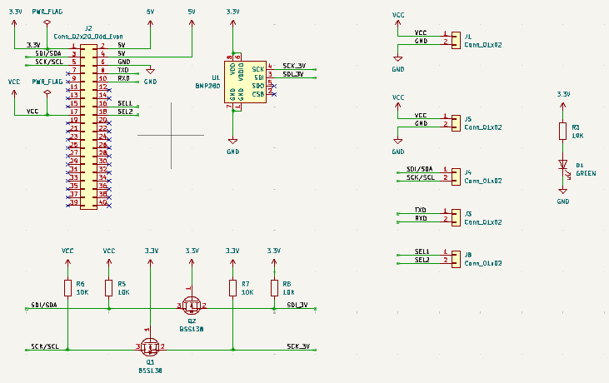
Custom PCB Design (Simple Adaptation)
Integrated Components
BMP280 Altimeter
JST Breakouts
2x20 Pin Connector
Small PCB adaptation schematic combining only altimeter module and JST breakouts.

Slide 9
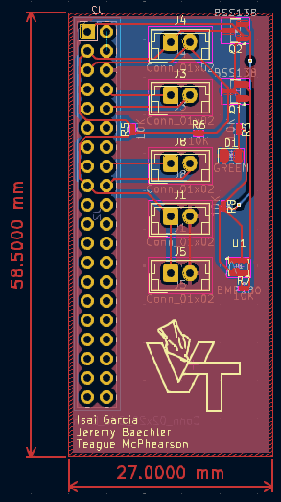
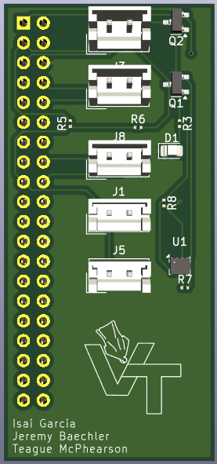
Custom PCB Design (Simple Adaptation)
Integrated Components
BMP280 Altimeter
JST Breakouts
2x20 Pin Connector
Small PCB adaptation layout (left) and 3D view (right) combining only altimeter module and JST breakouts.

Slide 10
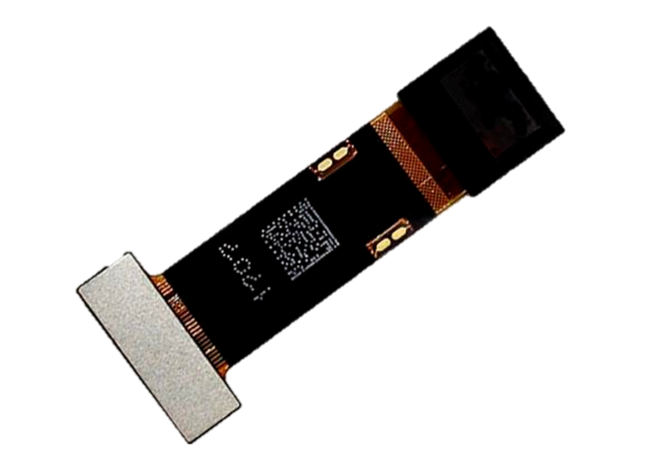
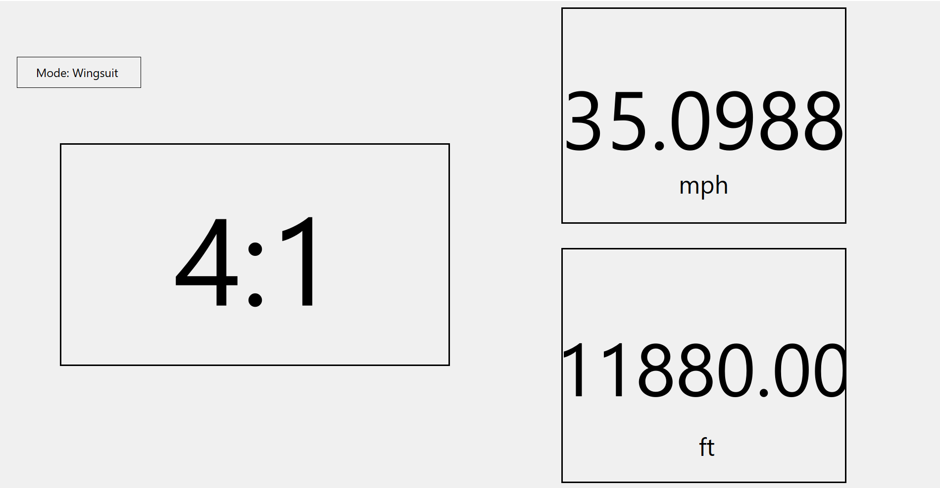
Qt Widget Application
Qt Creator
Glide Ratio (Left Box)
Speed in MPH (Top Right)
Altitude in ft (Bottom Right)

Slide 11
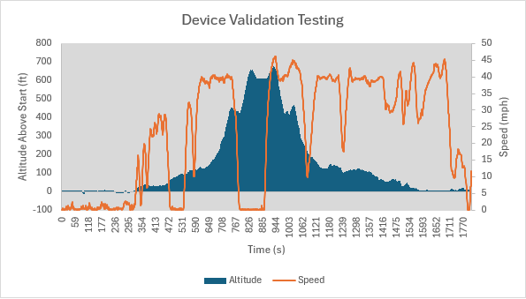
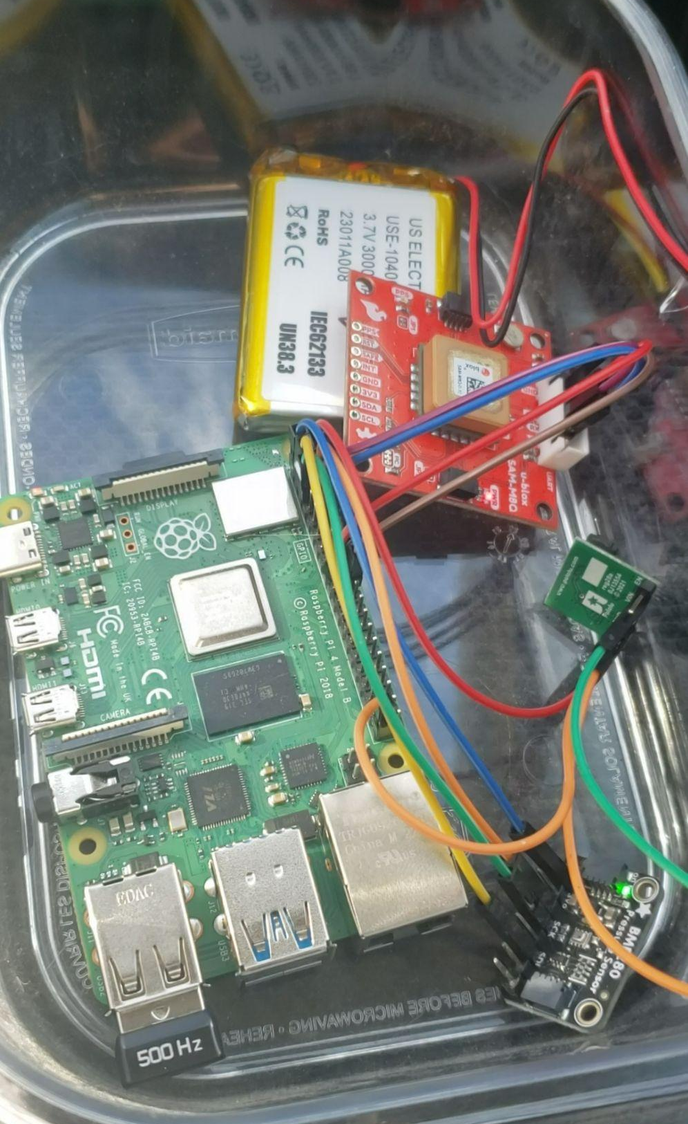
Results

Slide 12
Challenges and Takeaways
Cross Compilation Complexities
Port Accessibility
Driver Development
Integration and Testing
Flexibility
Collaboration and Teamwork
Adaptation
Insight in Testing

Slide 13
Steps Moving Forward
Add Glide Ratio Feature Functionality
Create Mobile Application For Data History
Implement PCB for Compactness
Boot2Qt Functionality
Further Explore Physical Appearance

